Slide 1
Procurement 3rd quarter training january 29, 2025

Slide 2
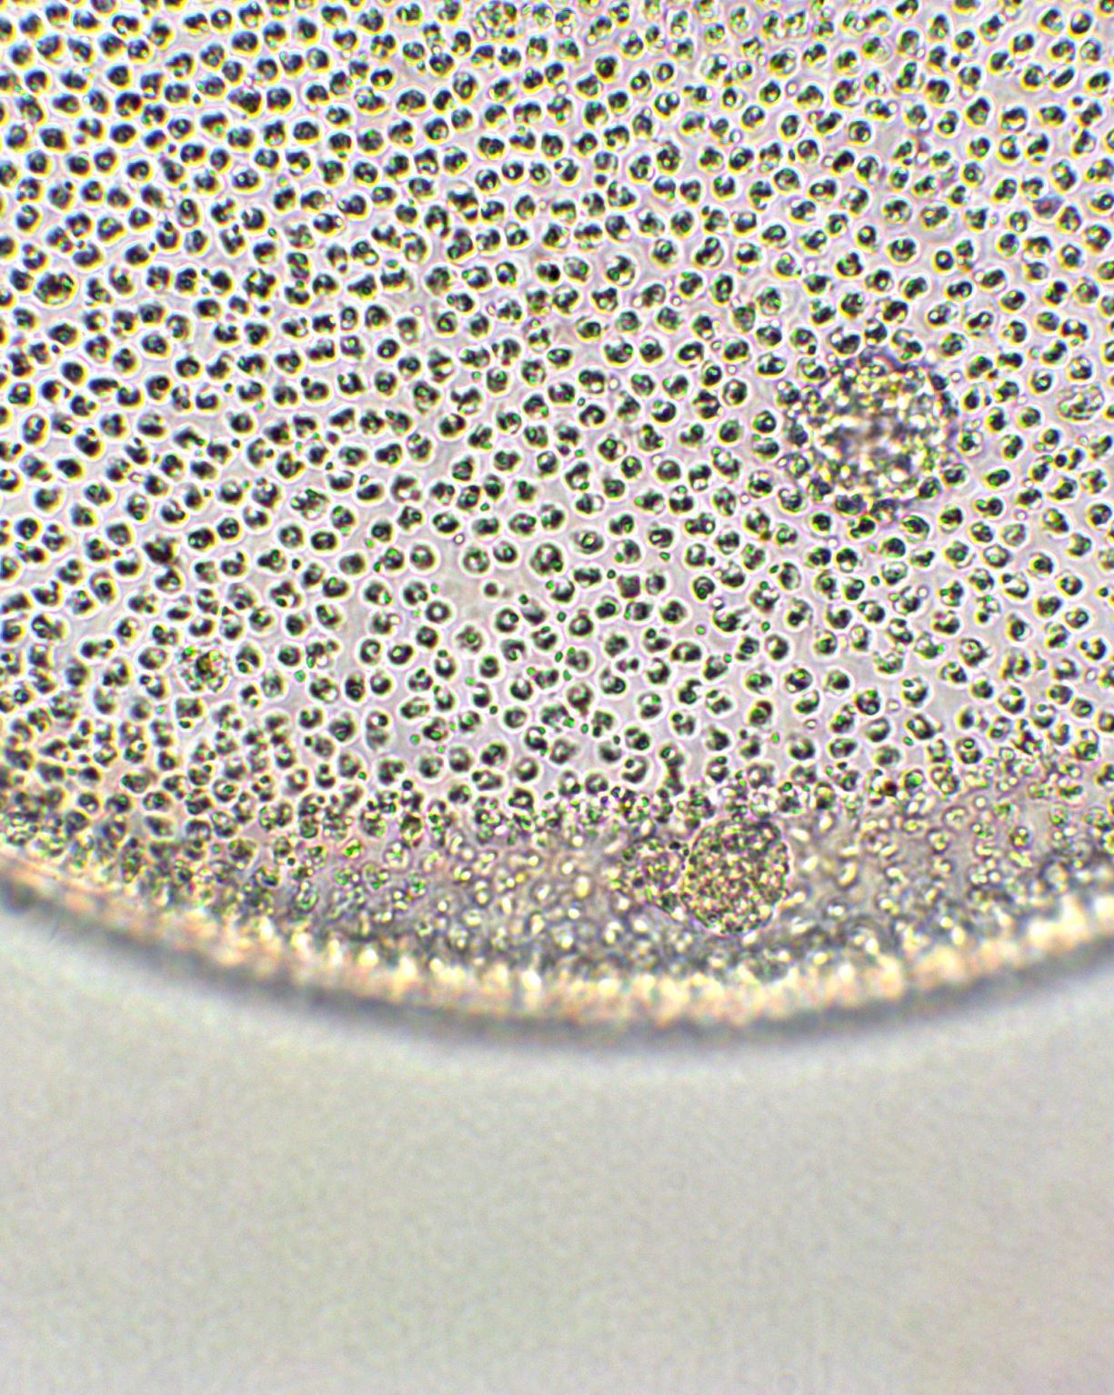
Director of Procurement & Other Support Services
Michael R. Castilleja
Micasti2@uiwtx.edu
210-805-3571
Administration Building, Room 79

Slide 3
Financial Polices & Procedures
Please refer to the Financial Policies and Procedures, on the Comptroller’s Office website for information on what is, and is not, allowed
https://my.uiw.edu/finance/comptroller/financial-policies-and-procedures.html

Slide 4
Purchasing
This Photo by Unknown Author is licensed under CC BY-SA

Slide 5
Purchasing Staff
Marisa Vasquez * 210-829-3999 * mfvasque@uiwtx.edu
Carmen Rivera * 210-805-5837 * rivera@uiwtx.edu
Jessica Cevallos * 210-805-1236 * jevarga1@uiwtx.edu
Lisa Bosquez * 210-805-5836 * lbosquez@uiwtx.edu

Slide 6
Fiscal Year 25 vs 26
30 May
Goods received or services rendered by May 31st must post to FY25.
1 June
Goods received or services rendered on or after June 1st must post to FY26.
Only if a check is needed by May 31, use the 1751 option.
June 1 Purchase Orders can be created once we have approval from Budgeting. Date TBA.
Purchase Order requests will be cut off April 25.

Slide 7
Review Open Encumbrances
Go to: FGIOENC
1. Enter FUND if needed
2. Enter ORG
3. Click GO

Slide 8
Review Open Encumbrances
List of PO’s will display

Slide 9
Review Open Encumbrances
Any remaining encumbrances at year end will roll forward to the next fiscal year if they are not completed or closed.
These funds will continue to remain encumbered against next year’s budget.

Slide 10
1st & 2nd Quarter Topics Any Questions?
Operational Justification
Furniture & Equipment
Promotional Items
Breakroom Supplies
Catering
Open PO Requests
Fixed Assets and Three Bids
Purchase Order Rider
Funding
Applying a discount
No $0 Description Lines
Backup documentation
Contract Review Portal
Commonly Used Accounts

Slide 11
P-Card & Travel Administration

Slide 12
Karissa Smith
P-Card & Travel Administrator
Phone: (210) 832-5488
P-Card Email: UIWCC@uiwtx.edu
Travel Email: UIWTRAVEL@uiwtx.edu

Slide 13
Travel Arrangements
Corporate Travel Planners (CTP)
613 NW Loop 410, Ste 400
San Antonio, TX 78216
Phone: (833) 708-0728
Email: UIW@ctptravelservices.com
*Travel must be approved by a supervisor prior to any travel reservation being made to ensure travel is properly authorized based on departmental needs and if sufficient funds are available in budget.

Slide 14
Airline reservation Template
REQUIRED INFORMATION

Slide 15
Individual vs Group travel
INDIVIDUAL
FOR ONE TO NINE TRAVELERS, EMAIL THE COMPLETED AIRLINE RESERVATION TEMPLATE TO UIW@CTPTRAVELSERVICES.COM
GROUP
FOR GROUPS OF 10 OR MORE TRAVELERS, YOU MUST COMPLETE THE CTP GROUP TRAVEL REQUEST FORM
https://app.smartsheet.com/b/form/e670487eaf7f48229a224e10f28f8969

Slide 16
Carrier selection & Seating
Southwest Airlines is preferred unless it does not fly to specific destination needed by traveler.
Another airline may be used if fee(s) are within $100 of the Southwest Airlines rate.
Seating must be economy or coach. UIW does not allow business class or first-class seating.
Special accommodations require prior approval by Supervisor. Please include approval documentation with your travel request to UIW@CTPTRAVELSERVICES.COM and copy uiwtravel@uiwtx.edu.

Slide 17
Traveling with a p-Card
AIRFARE SHOULD BE RESERVED THROUGH CTP ON THE UIW TRAVEL CARD, NOT YOUR ASSIGNED P-CARD.
P-CARDS ARE TO BE USED FOR ALL ALLOWED TRAVEL EXPENSES
PLEASE REMEMBE TO PRESENT THE STATE HOTEL OCCUPANCY TAX EXEMPTION CERTIFICATE WHEN STAYING IN HOTELS IN TEXAS.
TRAVEL ADVANCES AND REIMBURSMENTS ARE NOT AUTHORIZED FOR CARDHOLDERS
*Please refer to Sections 3, 4.5, and 4.6 of the UIW Financial Policies and Procedures Guide for detailed information on the Travel Policy and P-Card allowed/disallowed transactions.

Slide 18
Accounts Payable

Slide 19
Employee travel
Forms
General Travel Expense Report (GTER)
Expense Summary Form
Mileage Expense Reimbursement Form
To be used for in-town conferences and out-of town business related travel.
Advances
Complete top part of GTER and Column A section.
Advances are for Meals and Other expenses(taxi, parking and car rental).
Submit advance request to Accounts Payable 10 business days prior to travel.
Post Travel
Complete GTER top part, column B and after travel signatures submit within 10 business days from the return date of the trip to Accounts Payable.
Itemized receipts required for reimbursements.
Conference program/schedule at a glance/agenda

Slide 20
Employee travel
Post Travel cont’d
Complete the Expense Summary Form
Dates are the actual travel dates
List all daily expenses
The Per Diem is $50 per day.
Meal reimbursement is either Per Diem or Itemized Receipts the entire trip-not both.

Slide 21
Employee travel
Mileage Expense Reimbursement Form
Local & Out-of-Town Auto Travel
To be used for use of personal vehicle mileage
Travel past 80 miles from San Antonio, obtain quote from CTP prior to traveling.
Attach MapQuest or Google Maps with printed driving directions.
No mileage reimbursement is paid to or from airport.
Mileage rates are based on IRS guidelines, which may change on a yearly basis.

Slide 22
Budget, Planning & Analysis

Slide 23
Budgeting Staff
Amy DeAtley
Director of Budgeting, Planning & Analysis
210-283-6339
amoczyge@uiwtx.edu
Reynaldo "Rey" Rangel, Jr.
Budget Coordinator
210-829-6021
rerangel@uiwtx.edu

Slide 24
REVIEWING EXPENSES CHARGED TO ORG
Go to: FGIBDST
1. Enter ORG
2. Clear the PROG
3. Enter FUND
4. Click GO

Slide 25
DETAIL ORG EXPENSES
To see the detail on any account line – Place cursor on the YTD Activity box for the account line. Go to Related – Transaction Detail Information

Slide 26
how to see if the overall org has funding
Go to: FGIBSUM
1. Enter ORG
2. Enter FUND
3. Click GO

Slide 27
Overall ORG Budget Summary
Go to: FGIBSUM
Look at the Available Balance for the Direct Expenditures
If the amount is positive - Funds are available
If the amount is negative - No funds available

Slide 28
Questions?

