Slide 1
Procurement FY26 - 2nd Quarter Training
November 19, 2025 – SEC 2040

Slide 2
Michael R. Castilleja Director Of Procurement & Other Support Services
Accounts Payable P-card & Travel Program Postal Operations Purchasing Shipping & Receiving / Fixed Assets

Slide 3
The Life of an Invoice
Accounts Payable

Slide 4

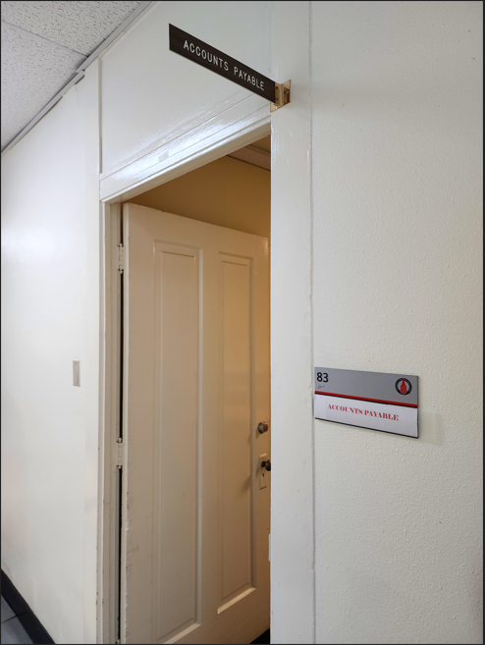
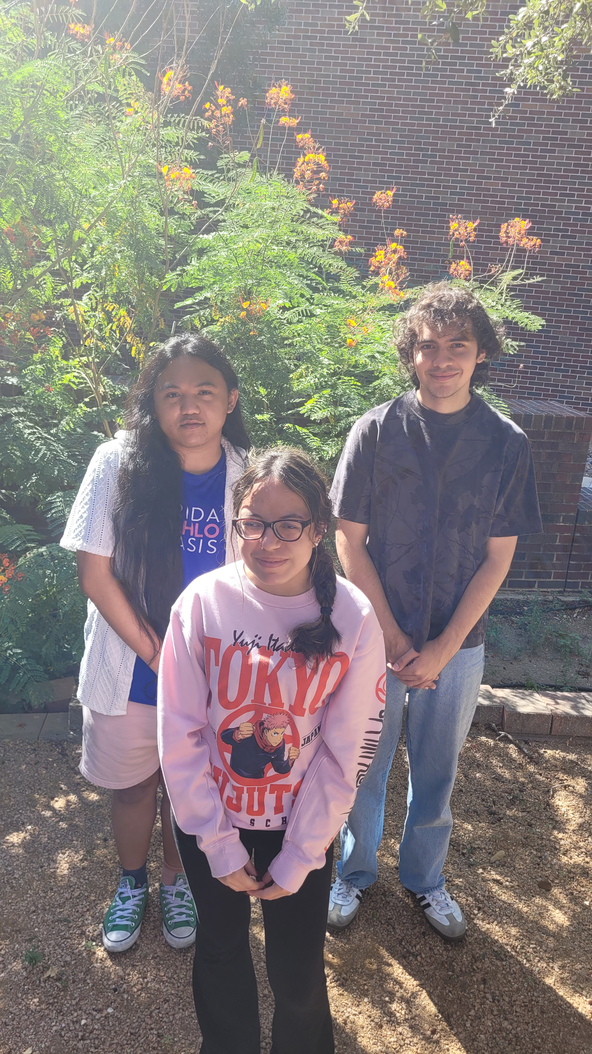
Melba Huerta
Suzette Haskell Senior AP Tech
Fran Trevino AP Tech
June 2024
Allen Work Study
Celeste Davey AP Tech
August 2024
Christian Work Study
Bety Carreno
AP Tech January 2025
Lizet Work Study

Slide 5
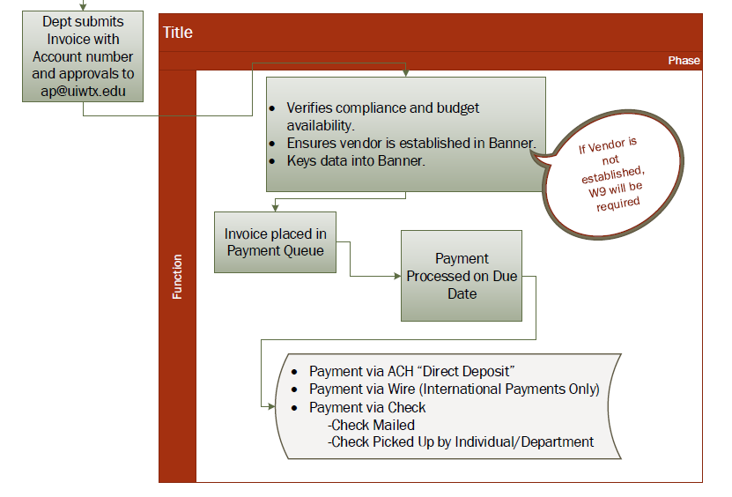
Receiving an Invoice
Rarely get physical mail
by post
time stamped & placed in basket (1 day sort period)
Almost all AP traffic comes through email.
AP Techs rotate responsibility of sorting this inbox (multiple eyes on an invoice + immediately sorted to appropriate tech)
Lightly review invoices (items of high importance/urgency, important if tech is absent etc.)
10 business days (two weeks) processing time from date received.
Notes:
We urge departments to email invoices/payment requests etc. as much as possible. It reduces paper and its faster.

Slide 6
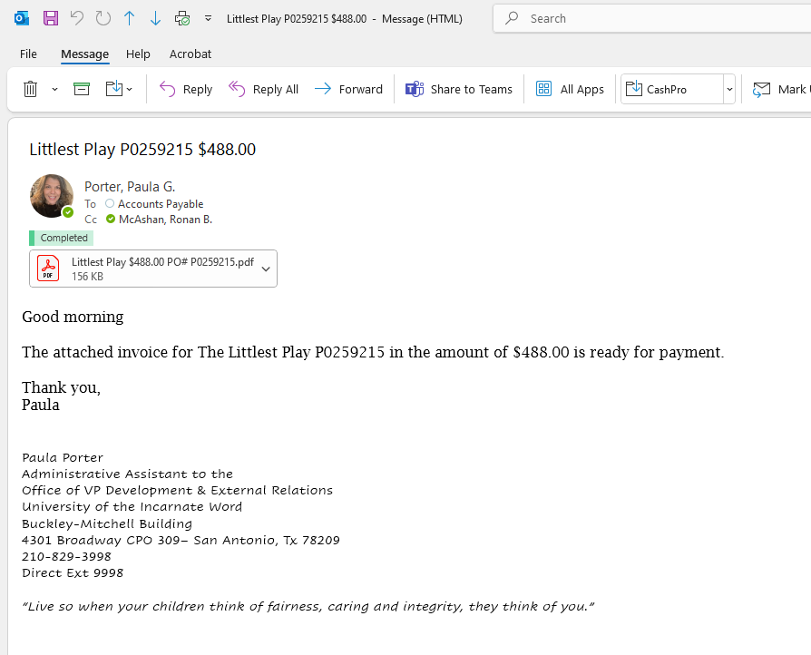
Receiving an Invoice
Invoices must be sent to ap@uiwtx.edu
Please only email AP unless the technician requests it.
Please only include payment request related to one vendor/payee per email.
Multiple PDF’s for the same vendor/payee should be attached separately to one email.
Add vendor/payee’s name and invoice number if available to the subject line of an email
If using Adobe, please set reminders to one week or more.
Daily reminders clutter and slow down the processing of an invoice.
Notes:
Outlook IS NOT a search engine. It helps tremendously when email subject lines include vendor name and invoice number. Add a dollar amount and/or PO# if you’re feeling generous.
Please only email/copy AP not the individual technician unless the technician has asked you to communicate directly with them.

Slide 7
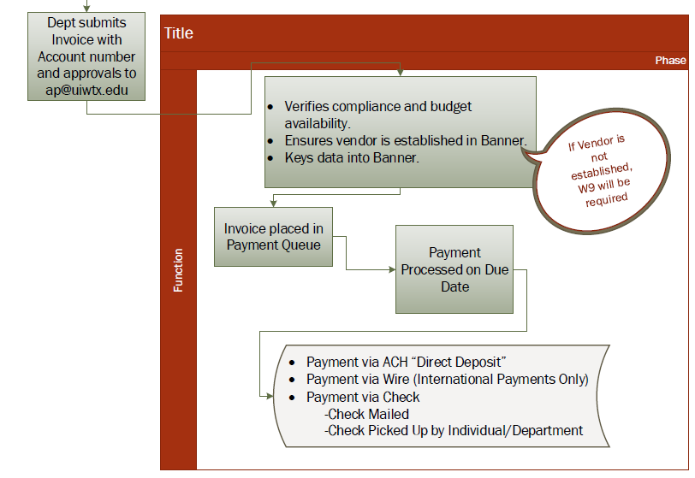
Reviewing Emails
Emails/Mail sorted to a tech does not equal immediate review. (10 day turn around period)
An accepted AdobeSign does not guarantee that it has been entered for payment.
GTER’s and Mileage can take longer to review because of how much information they have.
Items of urgency are prioritized and entered ASAP
Employee/Student Loans
Issue Checks
Advances
Before payment, we review for:
What type of payment it is
$ amount/Vendor #
PO Information/Budget number
Under $1k
Has approval signature
(Over 5K/Grants)
Due date
We can future date an invoice

Slide 8
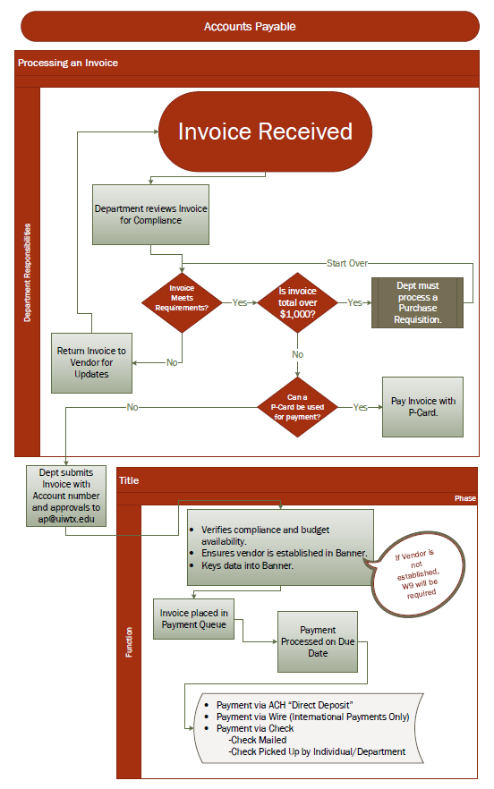

Reasons Why AP Sends Something Back
Invoice
Payment Request Form (PRF)
General Travel Expense Report (GTER)
Mileage Expense Reimbursement Form
Missing:
Who?
What/Why?
How?

Slide 9
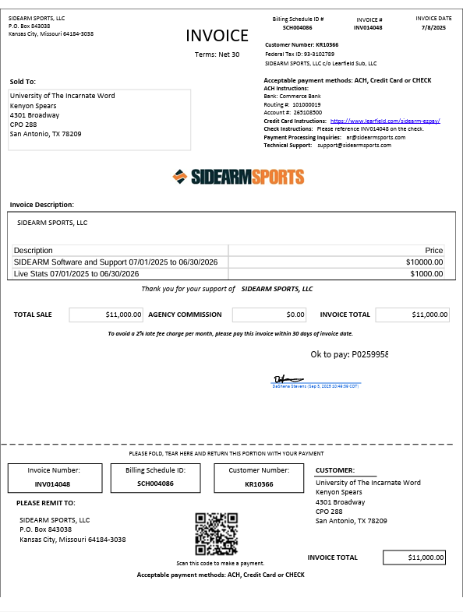
Invoice
Usually Not an Invoice:
-Order
-Statement
-Quote
-Packing Slips
Invoices have Invoice Numbers
What/Why
Invoice Vendor Name Must =
Name on PO which will = Name on Check
New Vendor –W-9
How
If over 1K, must have a PO# AND PO# needs to be on the invoice.
(Written or Printed)
If under 1K, budget number needs to be on the invoice and MUST be signed
If over 5K, MUST have Approval Signature on Invoice
(Even if there is a PO)
Digital / electronic signatures are preferred and should be legible.
Invoice DOES NOT need the budget number if there is a valid PO# on the invoice
What/Why
Who

Slide 10
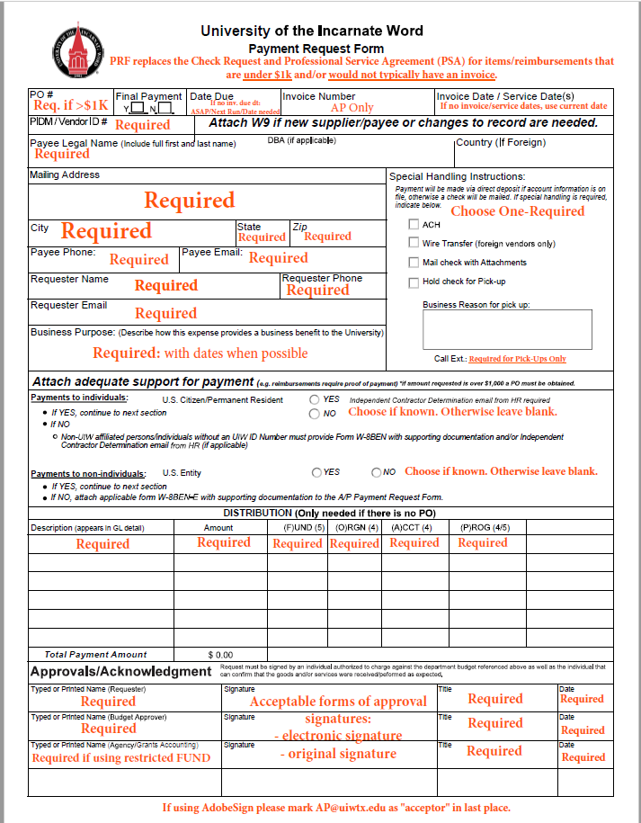
Payment Request Form (PRF)
Who
Replaces:
Check Requisition
and
Professional Services Agreement (PSA)
PRF is NOT needed for Invoiced Payments
How
What/Why
If under 1K, budget number needs to be on the form. NO PO Required
MUST have Approval Signature
Digital / electronic signatures are preferred and should be legible.
Payments from Restricted Funds: (2XXXX) Need Grants Signature
Support Docs
-Receipts
-Order/Quote - for Deposits
-Stipend/Award Letter

Slide 11
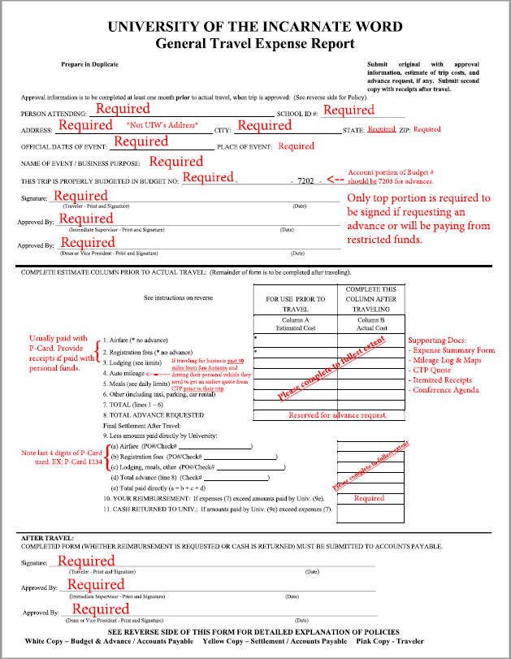
General Travel Expense Report (GTER)
Who
How
Must have Approval Signatures
Digital / electronic signatures are preferred and should be legible.
Advance: Top
Restricted Funds Pre-Travel Approval : Top
Reimbursement: Bottom
Payments from Restricted Funds: (2XXXX)
Need Grants Signature
What/Why
Supporting Documentation
A GTER does not need a PRF

Slide 12
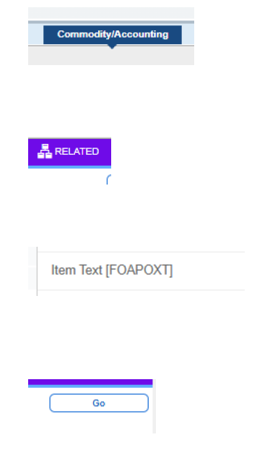
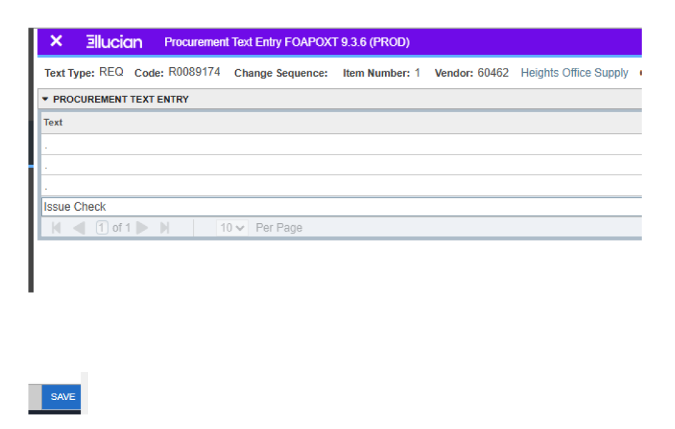
Issue Check PO
Items that do not require a PO regardless of dollar amount:
Stipends
FHEG-UIW Bookstore Charges
Business Office Student Fees
Subscriptions / Memberships
Study Abroad / Tuition
*List is not all inclusive*
*Creating a PO with “ISSUE CHECK” verbiage in the “Item Text [FOAPOXT]” signifies that a check is being requested for instances that Pre-payment is needed. E.g., deposits, registrations, etc.
Issue Check should be requested on a minimal basis.
Notes:
For urgent invoices and on a RARE occasion: deposits to vendors, after the fact invoices. If it has a future due date an issue check is not needed.
Services will need a PO regardless of $ amount.

Slide 13
Did you know?
Direct deposit through payroll and AP are two different things. UIW community can set themselves up for AP direct deposit through Cardinal Apps. AP can help set up vendors.
Credit Memos are treated like invoices. Please provide a budget number and approval signature like you would for an invoice so that we may process them.
Don’t know a vendor #? Ask us!
X6031
Teams one of us
Email AP@uiwtx.edu
Check Run Details:
Tuesdays & Thursdays
AP will call the requesting department when a check is ready for pick-up
Checks are mailed out by noon Wednesdays and Fridays (the day after a check run)
If you’d like noted versions of the PRF, travel and/or mileage forms please check out our Accounts Payable Forms online!
Notes:
When using tax exemptions go to the stores customer service area BEFORE shopping. Many stores will give you a store specific tax exemption card that you need to present at the register before you start scanning (Walmart/Sams Club etc).

Slide 14
P-Card & Travel Administration
Karissa Smith

Slide 15
General Information
P-Card program was created to facilitate the purchases of goods of $1,000 or less that do not require a Purchase Order or contract.
Purchases can be made in person, by phone or online.
Items should be shipped to main campus at 4301 Broadway, San Antonio, 78209 to be processed for delivery through the Shipping & Receiving Department.
The program is not intended to avoid or bypass compliance with the University’s Procurement and Bid Policy and the Travel and Entertainment Policy.

Slide 16
Allowable Purchases
Purchases of goods of $1,000 or less.
Exceptions to this threshold includes hotels, conference registrations, professional dues.
Travel expenses-hotels, meals, car rentals, ground transportation and other incidentals.
Gas for rental cars or fleet vehicles is allowed.
If using a personal vehicle for business purposes, a Mileage Reimbursement form must be submitted, with maps, to the AP office for reimbursement
Catering on campus of $250+ must have the first right of refusal from Sodexo and should be less than $1,000 to purchase with the p-card.
Email from Sodexo is required as part of the documentation for the expense report.
**TAX EXEMPTION CERTIFICATES MUST BE PRESENTED PRIOR TO MAKING THE PAYMENT**

Slide 17
Disallowed Transactions
Amazon
Sam’s
Membership club purchases
Furniture
Technology and software
Cash Advances
Personal expenses
Alcohol
Intentionally splitting transactions to bypass the set threshold of $1,000.
UIW Trademark, Registered or Licensed products.
*VIOLATIONS OF POLICIES WILL RESULT IN SUSPENSION OR CANCELLATION OF THE P-CARD*

Slide 18
Tax Exemptions
TAX EXEMPTION CERTIFICATES MUST BE PRESENTED TO THE VENDOR PRIOR TO PURCHASE
Sales tax exemption is required for all purchases with the exception of restaurants and gas stations.
Gas for rental or fleet vehicles only
Wal-Mart has their own process for tax exemptions
Hotel State Occupancy Tax Exemption is required for hotels in the state of Texas only.
Please make sure to check the receipt/folio to ensure the occupancy taxes are removed prior to leaving the hotel.
**TAXES CHARGED ARE CONSIDERED A PERSONAL EXPENSE WHICH WILL REQUIRE REIMBURSEMENT TO THE UNIVERSITY BY THE CARDHOLDER**

Slide 19
Where to find this information?
A link to the P-Card Policy can be found on the P-Card Website https://my.uiw.edu/finance/p-card-program.html
Hotel and Sales Tax Exemptions can be found on the AP Website https://my.uiw.edu/accountspayable/index.html under Accounts Payable Forms.
Both the AP and P-Card offices have business card sized tax exempt certificates in our office if needed.

Slide 20
Contact Information
Karissa Smith
(210) 829-5488
Office located in AD 84
P-Card related issues email: uiwcc@uiwtx.edu
CTP Travel related issues email: uiwtravel@uiwtx.edu

Slide 21
Purchasing

Slide 22

Located in AD 79
Marisa Vasquez mfvasque@uiwtx.edu 210-829-3999
Carmen Rivera rivera@uiwtx.edu 210-805-5837
Jessica Cevallos jevarga1@uiwtx.edu 210-805-1236
Lisa Bosquez lbosquez@uiwtx.edu 210-805-5836

Slide 23
Authorized Signatories
As a reminder, any invoice, contract, bid, proposal, agreement or other document that includes legal terms and conditions must go through the contract review process and submitted through the contract review portal. If you are not sure whether a document should go through the portal, please reach out to Ashley Wysong, administrative assistant in the Office of General Counsel, at contractadmin@uiwtx.edu.
Divisional Vice Presidents can sign operational contracts UNDER $50,000, AFTER proper review in the Contract Review Portal.
You need to obtain vendor's signature.
Once signed, by vendor, you can send to contractadmin@uiwtx.edu to request signature from the appropriate VP.

Slide 24
PO Rider
The Purchase Order (PO) Rider has been updated and expanded to cover a broader scope of purchases. As a result, certain purchases no longer require an additional contract.
For purchases over $1,000 that do not include legal terms and conditions, you should initiate the purchase order process in accordance with UIW’s Financial Policies.
For purchases under $1,000, authorized users may use a department’s p-card. See P-Card guidelines for further guidance.
When providing your vendors the PDF copy of the PO, you should also include a copy of the PO Rider.

Slide 25
Sole Source & Preferred Vendor
A minimum of three bids must be solicited for goods and services purchased in the amount of $25,000 or more.
Sole Source Vendor
When a vendor restricts the University to a single vendor or brand.
Preferred Vendor
Vendors must be assessed to confirm they provide fair and economical pricing on the goods and services they provide.
Sole Source/Preferred Vendor Justification Form can be found on the Purchasing webpage.
Form should be approved prior to submitting a purchase requisition.
Must be approved by Director of Procurement & Other Support Services.

Slide 26
Debarment & Suspension
New language added to each PO adding responsibility of Federal and State requirements on
Grant Funded transactions.
“IN PROVIDING THE GOODS AND/OR SERVICES BEING PURCHASED, THE VENDOR IDENTIFIED IN THIS
PURCHASE ORDER ACKNOWLEDGES AND CERTIFIES THAT VENDOR, ITS PRINCIPALS, EMPLOYEES AND
AGENTS ARE NOT PRESENTLY DISBARRED, SUSPENDED, PROPOSED FOR DEBARMENT, DECLARED
INELIGIBLE, OR VOLUNTARILY EXCLUDED FROM PARTICIPATION IN THIS TRANSACTION BY ANY FEDERAL
DEPARTMENT OR AGENCY, AND ARE NOT LISTED ON THE GOVERNMENT-WIDE EXCLUSIONS IN THE
SYSTEM FOR AWARD MANAGEMENT (SAM). VENDOR SHALL IMMEDIATELY NOTIFY THE BUYER IN WRITING
IF THIS CERTIFICATION IS NO LONGER ACCURATE. VENDOR FURTHER ACKNOWLEDGES THAT IT MAY NOT
ENGAGE IN ANY PERMITTED LOWER-TIER VENDOR WHO IS DEBARRED, SUSPENDED, PROPOSED
FOR DEBARMENT, DECLARED INELIGIBLE OR VOLUNTARILY EXCLUDED BY ANY FEDERAL DEPARTMENT
OR AGENCY, AND WARRANTS THAT IT WILL INCLUDE THIS CERTIFICATION IN ANY TRANSACTION
AGREEMENT WITH ANY LOWER-TIER VENDOR OR SUBCONTRACTOR.”

Slide 27
Questions?

